Slide 1
Data Structures

Slide 2
Linked Lists
  Review on Pointer, Dynamic Memory allocation and De-allocation
  Singly Linked Lists
  Doubly Linked Lists

Slide 3
Structures
Structures are aggregate data types built using elements of primitive data types.
Structure are defined using the struct keyword:
E.g.
struct Time{
int hour;
int minute;
int second;
};

Slide 4
The struct keyword creates a new user defined data type that is used to declare variables of an aggregate data type.
Structure variables are declared like variables of other types.
Syntax:
struct <structure tag> <variable name>;
E.g. struct Time timeObject,
struct Time *timeptr;

Slide 5
Accessing Members of Structure Variables
The Dot operator (.):
  to access data members of structure variables.
The Arrow operator (->):
to access data members of pointer variables pointing to the structure.
E.g. Print member hour of timeObject and timeptr.
cout<< timeObject.hour;
or
cout<<timeptr->hour;
TIP: timeptr->hour is the same as (*timeptr).hour.
The parentheses is required since (*) has lower precedence than (.).

Slide 6
Self-Referential Structures
Structures can hold pointers to instances of themselves.
struct node{
char name[10];
int count;
struct node *next;
};

Slide 7
Singly Linked Lists
Linked lists are the most basic self-referential structures.
Linked lists allow you to have a chain of structs with related data
A linked list is a linear data structure, in which the elements are not stored at contiguous memory locations.
The elements in a linked list are linked using pointers as shown in the below image:
In simple words, a linked list consists of nodes where each node contains a data field and a reference(link) to the next node in the list.

Slide 8
Why Linked List?
Arrays can be used to store linear data of similar types, but arrays have the following limitations:
  The size of the arrays is fixed: So we must know the upper limit on the number of elements in advance. Also, generally, the allocated memory is equal to the upper limit irrespective of the usage.
  Insertion of a new element / Deletion of a existing element in an array of elements is expensive: The room has to be created for the new elements and to create room existing elements have to be shifted but in Linked list if we have the head node then we can traverse to any node through it and insert new node at the required position.

Slide 9
Example:
In a system, if we maintain a sorted list of IDs in an array id[] = [1000, 1010, 1050, 2000, 2040].
If we want to insert a new ID 1005, then to maintain the sorted order, we have to move all the elements after 1000 (excluding 1000).
Deletion is also expensive with arrays until unless some special techniques are used. For example, to delete 1010 in id[], everything after 1010 has to be moved due to this so much work is being done which affects the efficiency of the code.

Slide 10
Advantages of Linked Lists over arrays:
  Dynamic Array.
  Ease of Insertion/Deletion.

Slide 11
Singly Linked Lists
Linked lists are the most basic self-referential structures.
Linked lists allow you to have a chain of structs with related data
Array vs. Linked lists
Arrays are simple and fast but we must specify their size at construction time.
This has its own drawbacks.
If you construct an array with space for n, tomorrow you may need n+1.Here comes a need for a more flexible system?

Slide 12
Drawbacks of Linked Lists:
Random access is not allowed. We have to access elements sequentially starting from the first node(head node). So we cannot do a binary search with linked lists efficiently with its default implementation.
Extra memory space for a pointer is required with each element of the list.
It takes a lot of time in traversing and changing the pointers.Reverse traversing is not possible in singly linked lists.
Direct access to an element is not possible in a linked list as in an array by index.
Searching an element is costly and requires O(n) time complexity.Sorting of linked list is very complex and costly.

Slide 13
Types of Linked Lists:
Simple Linked List – In this type of linked list, one can move or traverse the linked list in only one direction. It is also called “Singly Linked List”.
Doubly Linked List – In this type of linked list, one can move or traverse the linked list in both directions (Forward and Backward)
Circular Linked List – In this type of linked list, the last node of the linked list contains the link of the first/head node of the linked list in its next pointer and the first/head node contains the link of the last node of the linked list in its prev pointer

Slide 14
Basic operations on Linked Lists:
    Deletion
    Insertion
    Search
    Display

Slide 15
Singly Linked Lists
Representation of Singly Linked Lists:
linked list is represented by a pointer to the first node of the linked list. The first node is called the head of the linked list. If the linked list is empty, then the value of the head points to NULL.
Each node in a list consists of at least two parts:
A Data Item (we can store integer, strings, or any type of data).
Pointer (Or Reference) to the next node (connects one node to another) or An address of another node

Slide 16
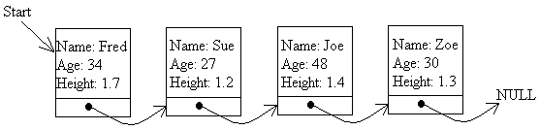
Creating Linked Lists in C++
A linked list is a data structure that is built from structures and pointers.
It forms a chain of "nodes" with pointers representing the links of the chain and holding the entire thing together.
A linked list can be represented by a diagram like this one:

Slide 17
Defining the data structure for a linked list
struct node
{ char name[20]; // Name of up to 20 letters
int age
float height; // In metres
node *next;// Pointer to next node
};
struct node *head =NULL

Slide 18
Adding a node to the list
  insertAtBeginning
  insertAtEnd
  insertAtferPosition
  insertBeforePosition

Slide 19
new node
insertAtBeginning
Steps:
1. Declare the space for a pointer item and assign a temporary pointer to it.
This is done using the new statement as follows:
node *temp = new node
name
age
Height next
temp

Slide 20
2. Ask the user to fill in the details of the person, i.e. the name, age, address or whatever:
cout << "Please enter the name of the person: ";
cin >> temp->name;
cout << "Please enter the age of the person : ";
cin >> temp->age;
cout << "Please enter the height of the person : ";
cin >> temp->height;
temp->next = NULL;

Slide 21
3. Set the pointer. For this we need to consider different cases.
Case 1: When the new node is added to an empty list.
i.e
if(head==NULL){
temp->next=NULL:
head=temp;
}
name
age
Height next
head
NULL

Slide 22
Case 2:Adding a new node at the beginning of a list that contains at least one node.
i.e
if(head!=NULL){
temp->next=head;
head=temp;
}
head
name
age
Height next
name
age
Height next
name
age
Height next
NULL
temp

Slide 23
//C++ Implementation of inserting a new node at the beginning of a //singly //linked list. Use the structure given below.
void insertBeginning(){
node* temp=new node;
cout<<"Enter Id:";
cin>>temp->id;
if(head==NULL){
temp->next=NULL;
}
else{
temp->next=head;
}
head=temp;
totalNodes++;
}
int totalNodes=0;
struct node{
int id;
node* next;
}*head=NULL;

Slide 24
new node
insertAtEnd
Steps:
1. Declare the space for a pointer item and assign a temporary pointer to it.
This is done using the new statement as follows:
node *temp = new node
name
age
Height next
temp

Slide 25
2. Ask the user to fill in the details of the person, i.e. the name, age, address or whatever:
cout << "Please enter the name of the person: ";
cin >> temp->name;
cout << "Please enter the age of the person : ";
cin >> temp->age;
cout << "Please enter the height of the person : ";
cin >> temp->height;
temp->next = NULL;

Slide 26
3. Set the pointer. For this we need to consider different cases.
Case 1: When the new node is added to an empty list.
i.e
if(head==NULL){
temp->next=NULL:
head=temp;
}
name
age
Height next
head
NULL
temp

Slide 27
Case 2:Adding a new node at the end of a list that contains at least one node.
i.e if(head!=NULL){
node* curr=head;
temp->next=NULL;
while(curr->next!=NULL){
curr=curr->next;
}
curr->next=temp;
}
head
name
age
Height next
name
age
Height next
NULL
NULL
name
age
Height next
temp

Slide 28
//C++ Implementation of inserting a new node at the end of a
//singly linked list. Use the structure given below.
int totalNodes=0;
struct node{
int id;
node* next;
}*head=NULL;
void insertEnd(){ node* temp=new node; cout<<"Enter Id:"; cin>>temp->id; temp->next=NULL; if(head==NULL){ head=temp; } else{ node* curr=head; while(curr->next!=NULL){ curr=curr->next; } curr->next=temp; } totalNodes++; }

Slide 29
Inserting a node before a given node
void insert_beforeNode(){
int location;
cout<<"Insertion before which node?";
cin>>location;
node* temp=getNode();
if(head==NULL){
temp->next=NULL;
head=temp;
}

Slide 30
else if(location==1){
temp->next=head;
head=temp;
}
else{
node* curr=head;
for(int i=1;i<(location-1);i++){
curr=curr->next;
}
temp->next=curr->next;
curr->next=temp;
}
}

Slide 31
node* getNode(){
node* temp=new node;
cout<<"Name:";
cin>>temp->name;
cout<<"Id :";
cin>>temp->id;
return temp;
}

Slide 32
Inserting a node after a given node
Exercise

Slide 33
Deleting a node from the list
we have three choices:
  Delete a node from the start of the list,
  delete one from the end of the list, or
  delete one from somewhere in the middle.
When a node is deleted, the space that it took up should be reclaimed. Otherwise the computer will eventually run out of memory space. This is done with the delete instruction:
delete temp; // Release the memory pointed to by temp

Slide 34
Deletion in singly linked list at beginning
Deleting a node from the beginning of the list is the simplest operation of all.
Since the first node of the list is to be deleted, therefore, we just need to make the head, point to the next of the head. This will be done by using the following statements.
    temp= head;
    head = temp->next;
    delete temp;

Slide 35
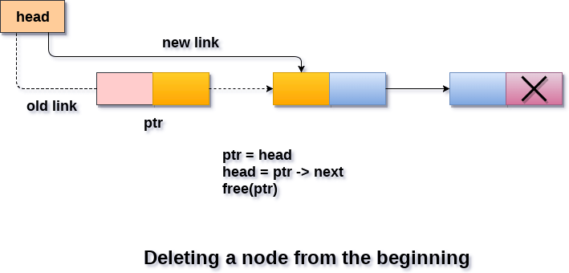
Algorithm
Step 1: IF head = NULL
Write UNDERFLOW
Go to Step 5
[END OF IF]
Step 2: SET temp = head
Step 3: SET head = head->next
Step 4: delete temp
Step 5: EXIT

Slide 36
void delete_start_node()
{
node *temp;
temp = head;
head = head->next
delete temp;
}

Slide 37
Deletion in singly linked list at the end
There are two scenarios in which, a node is deleted from the end of the linked list.
  There is only one node in the list and that needs to be deleted.
  There are more than one node in the list and the last node of the list will be deleted.

Slide 38
In the first scenario,
the condition
head → next = NULL will survive and therefore, the only node head of the list will be assigned to null. This will be done by using the following statements.
    temp= head ;
    head = NULL ;
    delete temp;

Slide 39
In the second scenario,
The condition head → next = NULL would fail and therefore, we have to traverse the node in order to reach the last node of the list.
For this purpose, just declare a temporary pointer temp and assign it to head of the list.
We also need to keep track of the second last node of the list. For this purpose, two pointers temp and temp1 will be used where temp will point to the last node and temp1 will point to the second last node of the list.
this all will be done by using the following statements.

Slide 40
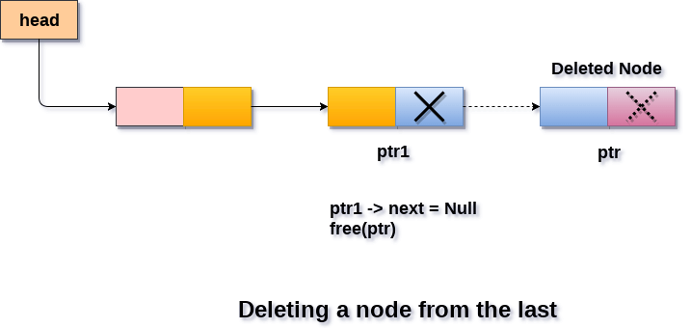
temp= head;
while(temp->next != NULL)
{
temp1 = temp;
temp = temp->next;
}
Now, we just need to make the pointer temp1 point to the NULL and the last node of the list that is pointed by temp will become free. It will be done by using the following statements.
    temp1->next=null;
    delete temp;

Slide 41
Algorithm
Step 1: IF HEAD = NULL
Write UNDERFLOW
Go to Step 8
[END OF IF]
Step 2: SET temp = head
Step 3: Repeat Steps 4 and 5 while temp -> next!= NULL
Step 4: SET temp1 = temp
Step 5: SET temp= temp->next
[END OF LOOP]
Step 6: SET temp1 -> NEXT = NULL
Step 7: delete temp
Step 8: EXIT

Slide 42
void delete_end_node()
{ node *temp1, *temp2;
if (start_ptr == NULL)
cout << "The list is empty!" << endl;
else
{ temp1 = start_ptr;
if (temp1->nxt == NULL) // This part is new!
{ delete temp1;
start_ptr = NULL;
}
else
{ while (temp1->nxt != NULL)
{ temp2 = temp1;
temp1 = temp1->nxt;
}
delete temp1;
temp2->nxt = NULL;
}
}
}

Slide 43
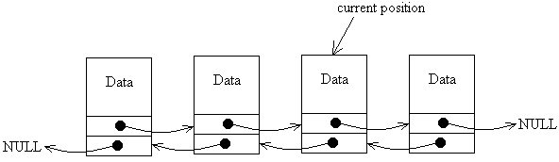
Doubly Linked Lists
A doubly linked list is one where there are links from each node in both directions

Slide 44
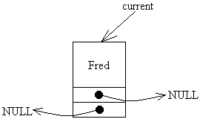
. Creating Doubly Linked Lists
The nodes for a doubly linked list would be defined as follows:
struct node{
char name[20];
node *nxt; // Pointer to next node
node *prv; // Pointer to previous node
};
node *current;
current = new node;
current->name = "Fred";
current->nxt = NULL;
current->prv = NULL;

Slide 45
Adding a Node to a Doubly Linked List
void add_node_at_start (string new_name)
{ // Declare a temporary pointer and move it to the start
node *temp = current;
while (temp->prv != NULL)
temp = temp->prv;
// Declare a new node and link it in
node *temp2;
temp2 = new node;
temp2->name = new_name; // Store the new name in the node
temp2->prv = NULL; // This is the new start of the list
temp2->nxt = temp; // Links to current list
temp->prv = temp2;
}

Slide 46
void add_node_at_end ()
{ // Declare a temporary pointer and move it to the end
node *temp = current;
while (temp->nxt != NULL)
temp = temp->nxt;
// Declare a new node and link it in
node *temp2;
temp2 = new node;
temp2->name = new_name; // Store the new name in the node
temp2->nxt = NULL; // This is the new start of the list
temp2->prv = temp; // Links to current list
temp->nxt = temp2;
}

Slide 47
Circular Linked List
The circular linked list is a linked list where all nodes are connected to form a circle.
In a circular linked list, the first node and the last node are connected to each other which forms a circle. There is no NULL at the end.

Slide 48
Operations on the circular linked list:
We can do some operations on the circular linked list similar to the singly linked list which are:
    Insertion
      Insertion at the beginning of the list
      Insertion at the end of the list
      Insertion in between the nodes
    Deletion
      Delete the node only if it is the only node in the circular linked list:
      Deletion of the last node

Slide 49
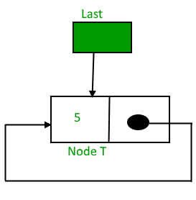
Insertion in a circular linked list:
A node can be added in three ways:
Insertion in an empty list
Insertion at the beginning of the list
Insertion at the end of the list
Insertion in between the nodes
Insertion in an empty List:
Initially, when the list is empty, the last pointer will be NULL.

Slide 50
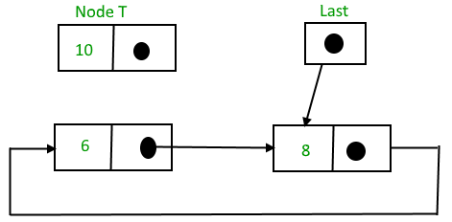
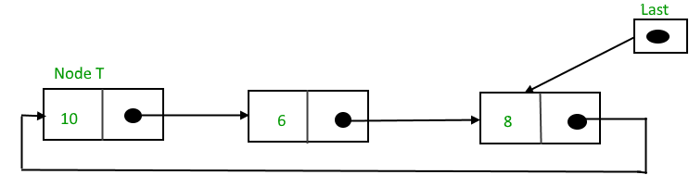
Insertion at the beginning of the list
After insertion,

Slide 51
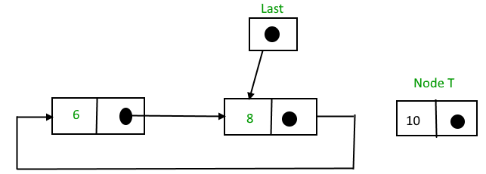
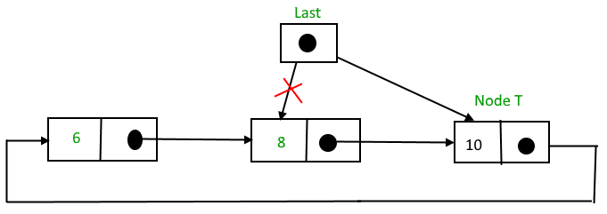
Insertion at the end of the list
After insertion

Slide 52
2. Deletion of the last node:
  Locate the node before the last node (let it be temp)
  Keep the address of the node next to the last node in temp
  Delete the last memory
  Put temp at the end

Slide 53
3. Delete any node from the circular linked list:
Algorithm:
Case 1: List is empty.
  If the list is empty we will simply return.
Case 2:List is not empty
  If the list is not empty then we define two pointers curr and prev and initialize the pointer curr with the head node

Slide 54
Traverse the list using curr to find the node to be deleted and before moving to curr to the next node, every time set prev = curr.
If the node is found, check if it is the only node in the list. If yes, set head = NULL and free(curr).
If the list has more than one node, check if it is the first node of the list. Condition to check this( curr == head).
If yes, then move prev until it reaches the last node. After prev reaches the last node, set head = head -> next and prev -> next = head. Delete curr.
If curr is not the first node, we check if it is the last node in the list. Condition to check this is (curr -> next == head).

Slide 55
If curr is the last node. Set prev -> next = head and delete the node curr by free(curr).
If the node to be deleted is neither the first node nor the last node, then set prev -> next = curr -> next and delete curr.

